Slide 1
DATA 468: Applied Stochastic Process
by
Dr. Zakir
Department of Mathematics University of Arizona
Email: zakir@arizona.edu

Slide 2
Outline
Stochastic Process
Continuous-time Stochastic process
Discrete-time Stochastic process
Stochastic Processes as Random Functions
Mean Function of a Random Process
Autocorrelation and Auto-covariance
Supplementary reading
3
4

Slide 3
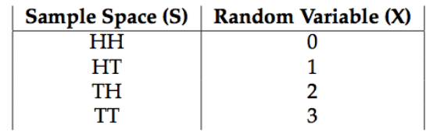
Random Variables
Random experiment: physical situation whose outcome cannot be predicted until it is observed.
Random Variable : X : S → R. For every event in Ω, X is a function that maps Ω to a real number line R.
Consider flipping a fair coin 2 times.
+infinity
Ω
HH
TT
HT
TH
Flipping the
coin（H or T）
Real Number line
Outcome
Ω={ω₁, ω₂,⋯, ω_{n}} or Ω={ω₁, ω₂,⋯}, Event: E={ω₁, ω₂}.
-infinity
Notes:
https://www.stat.auckland.ac.nz/~fewster/325/notes/ch1annotated.pdf

Slide 4
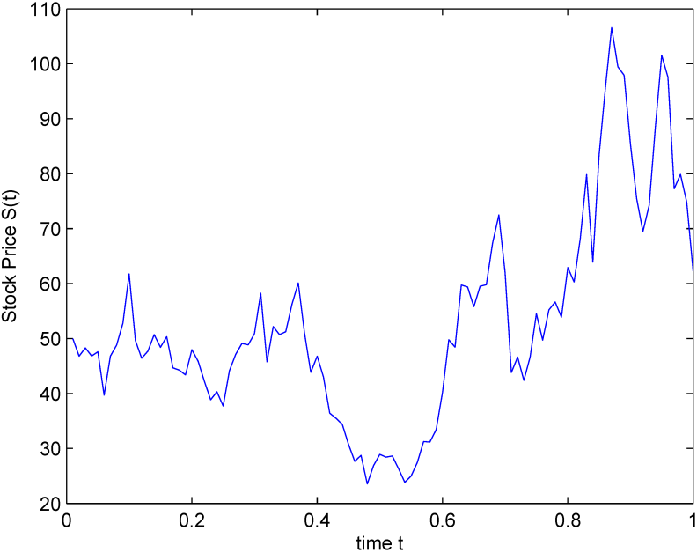
Stochastic/Random Process
Stochastic process assigns a function of time to each outcome, a dynamic, evolving system of random variables.
A set of random variables indexed by time {X_{t}} where t⊆ R, is called stochastic process or random process.
Examples:
Let X_{t} or X(t) be the temperature in Beijing at time t ∈ [0, ∞).
Let W (t) be the thermal noise generated across a resistor in an electric circuit at time t, for t ∈ [0, ∞).
Let X(t) be the stock price at time t for t∈ [0, ∞).
Notes:
https://zorro-project.com/manual/en/Lecture%206.htm
https://www.stat.auckland.ac.nz/~fewster/325/notes/ch1annotated.pdf

Slide 5
Discrete and continuous-time random process
Continuous-time: { X(t), t ∈ ℝ}, t is uncountable, i.e., interval on the real line , [−1, 1], [0,∞), (− ∞, ∞) etc
Discrete-time: {X(t), t ∈ ℕ}, sequence of random variables, discrete-time random processes are sometimes referred to as random sequences.
Notes:
Ω: The set of outcomes, F: the σ-algebra of events, and P is the probability measure on the sample space (Ω,F).
Very nice silides: https://sps.ewi.tudelft.nl/Education/courses/ee2s31/slides/SP1.pdf
https://web.mat.upc.edu/josep.fabrega/pipe/processes_intro-e-handout-4pp.pdf
Full course: https://onlinecourses.nptel.ac.in/noc24_ma72/preview
Numerical problems: https://svcn.ac.in/casestudy/ece/ece_ln/ece_ln_2_2_5.pdf
Numerical problems: http://contents2.kocw.or.kr/KOCW/document/2017/korea/sukjunhui/3.pdf

Slide 6
Random Variable vs Random Process
Feature | Random Variable | Random Process
Definition | A variable whose value is subject to randomness | A collection of random variables indexed by time (or space)
Notation | X | X(t)or X(t,ω)
Input | Probability space | Probability space and time (or space index)
Output | Single random outcome | A function over time (a stochastic signal)
Examples | Outcome of a die roll | Temperature over time at a location
Application | Probability theory, statistics | Signal processing, control systems, finance

Slide 7
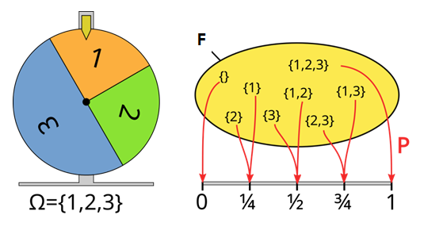
Probability Space (Ω F P)
Each random variable(X_{t}​) is defined on a common probability space (Ω, F, P).
(i) Sample Space/State Space(Ω): which lists all possible outcomes, where an outcomes is written as ω.
(ii) σ-algebra (F): A collection of subsets of Ω that define events.
If some set A is in F, then so is its complement, X∖A.
If A₁, A₂, A₃,… are in F, then so is A=A₁∪A₂∪A₃∪⋯.
(iii) Probability Measure (P): A function that assigns probabilities to events in F, P : F → [0, 1] .
Notes:
https://simple.wikipedia.org/wiki/Probability_space
https://www.statlect.com/glossary/probability-space
https://rinterested.github.io/statistics/measure_theory.html
the union of a countable number of sets, where each set in the union is indexed by a natural number.

Slide 8
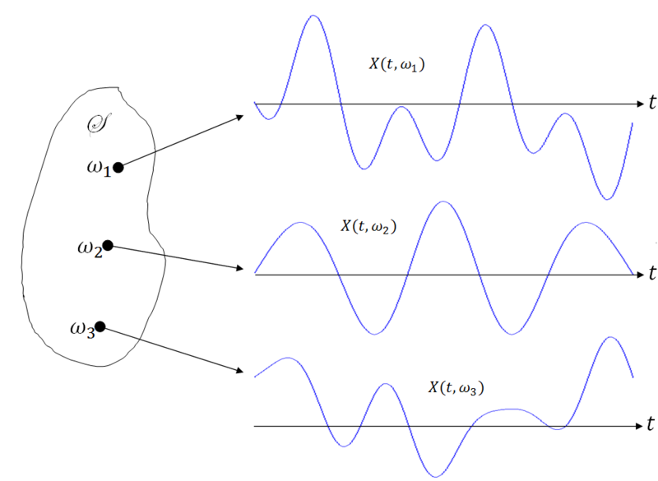
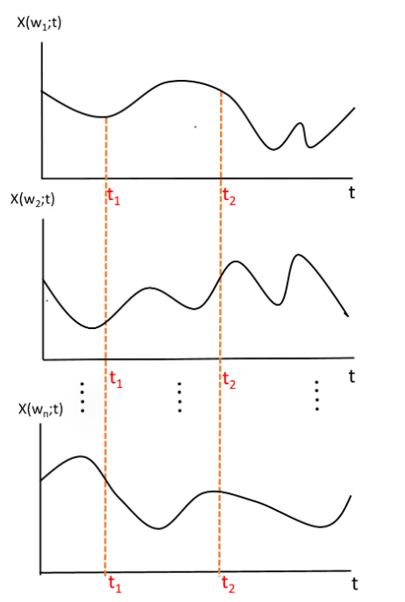
For fixed t
For fixed ω: X(ω_{i}, t) it is called a sample path or a sample function or a sample realization of X(t).
(1): X(t, ω) =X(t)) : random process.
(2): X(t₀, ω): random variable for fixed t₀.
(3): X(t, ω₀) : real-valued function of t for fixed ω₀.
(4): X(t₀, ω₀) is a real number for fixed t₀ and ω₀.
Notes:
https://www.youtube.com/watch?v=kSpSrWOTAKM
https://towardsdatascience.com/comprehensive-overview-of-random-variables-random-processes-and-their-properties-part-2-4cf352a9b7f2/
Best explanation of sample path: https://bookdown.org/danielcavey27/lecture_notes/stochastic-process-and-markov-chains.html
https://towardsdatascience.com/comprehensive-overview-of-random-variables-random-processes-and-their-properties-part-1-5c4692a338c6/

Slide 9
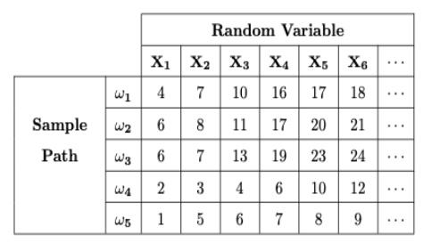
For fixed ω: X(ω_{i}, t) it is called a sample path or a sample function or a sample realization of X(t).
Notes:
https://www.youtube.com/watch?v=kSpSrWOTAKM
https://towardsdatascience.com/comprehensive-overview-of-random-variables-random-processes-and-their-properties-part-2-4cf352a9b7f2/
Best explanation of sample path: https://bookdown.org/danielcavey27/lecture_notes/stochastic-process-and-markov-chains.html
https://towardsdatascience.com/comprehensive-overview-of-random-variables-random-processes-and-their-properties-part-1-5c4692a338c6/

Slide 10
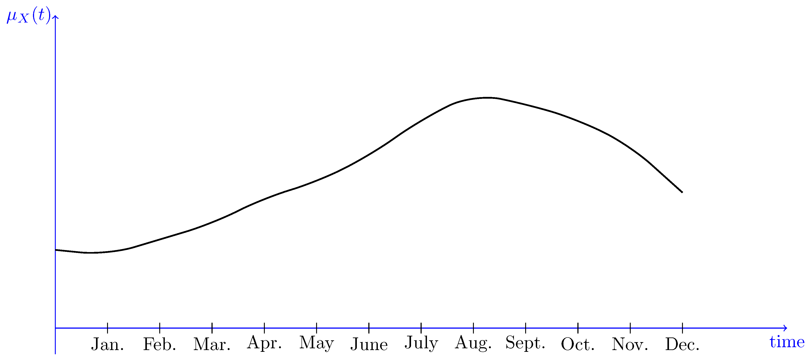
Properties of Random Process: mean function
A random process is described by some properties such as the mean, autocorrelation, cross-correlation, auto-covariance etc.
For a random process {X(t), t∈J}, the mean function μ_{X}(t):J→R, is defined as μ_{X}(t)=E[X(t)], where at each t, X(t) is a random variable with its own expected value.
If X(t) is the temperature in a certain city, the mean function μ_{X(t)} might look like the function shown in the following Figure. As we see, the expected value of X(t) is lowest in the winter and highest in summer.
Notes:
https://www.probabilitycourse.com/chapter10/10_1_2_mean_and_correlation_functions.php

Slide 11
Example1: Mean
You have 1000 dollars to put in an account with interest rate R, compounded annually. That is, if Xn is the value of the account at year n, then Xn=1000(1+R)^{n}, for n=0,1, 2, ⋯. The value of R is a random variable that is determined when you put the money in the bank, but it does not change after that. In particular, assume that R∼Uniform(0.04,0.05).
Find all possible sample functions for the random process {Xn, n=0,1,2,...}.
For any Specific value of R=r, Xn​=1000(1+r)^{n}, for r∈[0.04, 0.05], and n≥0.
Sample Function of X_{n} is f(n)= 1000(1+r)^{n}
Find the expected value of your account at year three( E[X₃]=?).
Notes:
https://www.probabilitycourse.com/chapter10/10_1_0_basic_concepts.php#example10_1

Slide 12
Example 2: Mean
Let {X(t), t∈[0,∞)} be defined as X(t)=A+Bt, for all t∈[0,∞), A and B are independent normal N(1,1) random variables.
(1): Find all possible sample functions for this random process.
(2): Define the random variable Y=X(1). Find the PDF of Y.
Solution:
Lets A=a and B=b, then X(t)=a+bt (sample functions , t≥0).
Y=X(1)=A+B , since A and B are independent N(1,1)=N(μ, σ²) random variables, Y=A+B is also normal with E(Y)=E(A+B)=E(A)+E(B)=1+1=2
Var(Y)=Var(A+B)=Var(A)+Var(B)(since A and B are independent)=1+1=2.
General expression of the Normal the pdf with normal distribution.
Notes:
https://www.compart.com/en/unicode/category/Sm
https://www.compart.com/en/unicode/category/

Slide 13
Example2: Mean
Let also Z=X(2).
Find E[YZ]
Solution:
E[YZ]=E[(A+B)(A+2B)]
=E[A²+3AB+2B²]
=E[A²]+3E[AB]+2E[B²]
=2+3E[A]E[B]+2⋅2 (since A and B are independent)=9.
Var(A)=E[A²]−(E[A])²
E[A²]=Var(A)+(E[A])²=2
Notes:
https://dlsun.github.io/probability/mean-function.html

Slide 14
Auto-correlation
The correlation of the random process X(t) with itself at different points in time.
Notes:
https://www.probabilitycourse.com/chapter10/10_1_0_basic_concepts.php#example10_1

Slide 15
Auto-covariance
The covariance of the random process X(t) with itself at different points in time.
Notes:
https://dlsun.github.io/probability/cov-function.html
https://sites.google.com/view/muqaibel/teaching/courses/ee315-probability-and-random-processes-for-engineers

Slide 16
PDF of a random process
A PDF describes the likelihood of a continuous random variable taking on a particular value.
For a continuous variable X, the PDF is a function f(x) such that:
The PDF itself does not give probabilities directly — the probability that X is in an interval is the area under the curve of f(x) over that interval.
Random processes are characterized by joint probability distributions, which describe the probabilities of the variables at different time points.
Notes:
https://youtu.be/3VYupIsbLlY?si=7fuuUb7LyOyUkCTJ
https://dlsun.github.io/probability/random-process.html

Slide 17
PDF: Example
Consider the random process {Xn, n=0,1,2,⋯}, in which Xi's are i.i.d. standard normal random variables. Write down f_{Xn}(x) for n=0, 1, 2, ⋯.
Write down f_{XmXn}(x₁, x₂) for m≠n, Since Xn∼N(0,1), we have
If m≠n, then X_{m} and X_{n} are independent (because of the i.i.d. assumption), so
Notes:
https://youtu.be/3VYupIsbLlY?si=7fuuUb7LyOyUkCTJ
https://dlsun.github.io/probability/random-process.html

Slide 18
CDF of a Random process
Consider the random process {X(t), t∈J}. For any t₀∈J, X(t₀) is a random variable, so we can write its CDF.
If t₁, t₂∈J , and X(t₁) and X(t₂) , then a random process has a family of CDFs, one for each time t.
For t₁, t₂, ⋯, t_{n}∈J, we can write F_{X(t1) X(t2)⋯, X(tn)}(x₁, x₂,⋯, x_{n})=P(X(t₁)≤x₁, X(t₂)≤x₂, ⋯, X(t_{n})≤x_{n}).
Notes:
https://www.projectrhea.org/rhea/index.php/ECE600_F13_Stochastic_Processes_mhossain
https://towardsdatascience.com/comprehensive-overview-of-random-variables-random-processes-and-their-properties-part-2-4cf352a9b7f2/
https://towardsdatascience.com/comprehensive-overview-of-random-variables-random-processes-and-their-properties-part-1-5c4692a338c6/
https://www.probabilitycourse.com/chapter10/10_1_1_PDFs_and_CDFs.php

Slide 19
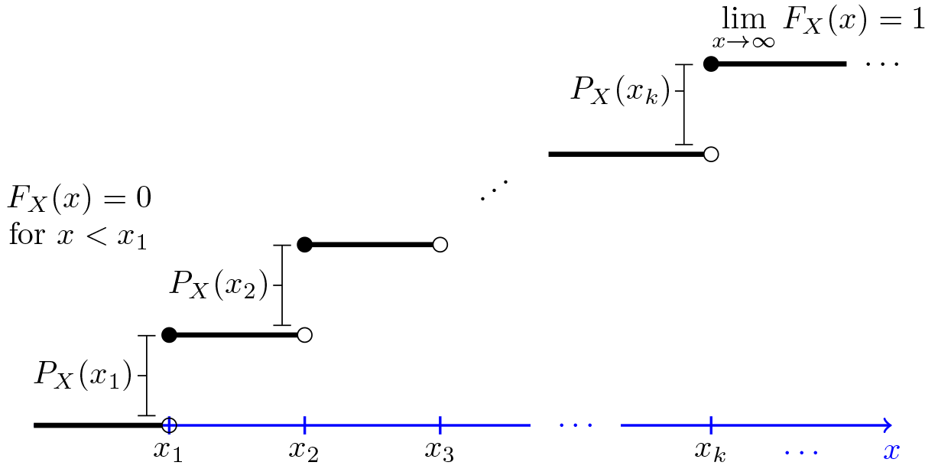
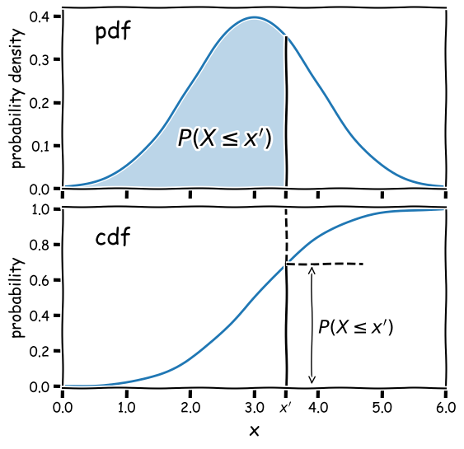
Supplementary readings: PDF, CDF & PMF
Notes:
https://www.pnw.edu/wp-content/uploads/2020/03/lecturenotes5-10.pdf
https://www.probabilitycourse.com/chapter6/6_1_1_joint_distributions_independence.php

Slide 20
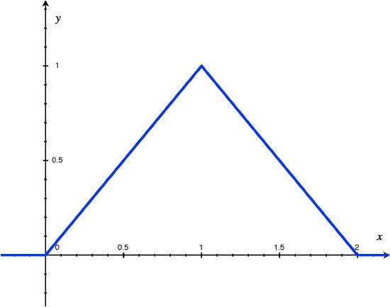
Supplementary readings: Example
Let X denote the time a person waits for an elevator to arrive. Suppose the longest wait for is 2 minutes, so that the possible values of X (in minutes) are given by the interval [0,2]. Calculate the probability that a person waits less than 30 seconds for the elevator to arrive P(0≤X≤0.5).
Notes:
https://www.pnw.edu/wp-content/uploads/2020/03/lecturenotes5-10.pdf

Slide 21
Supplementary readings: CDF Examples
Outcome | Probability | Cumulative Probability
2 | 1/36 | 1/36
3 | 2/36 | 3/36
4 | 3/36 | 6/36
5 | 4/36 | 10/36
6 | 5/36 | 15/36
7 | 6/36 | 21/36
8 | 5/36 | 26/36
9 | 4/36 | 30/36
10 | 3/36 | 33/36
11 | 2/36 | 35/36
12 | 1/36 | 36/36=1
Notes:
https://www.simplilearn.com/tutorials/statistics-tutorial/cumulative-distribution-function

Slide 22
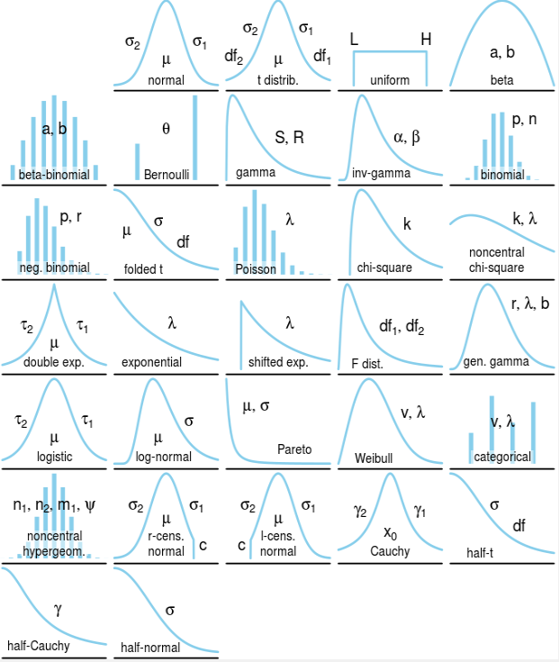
Supplementary reading: Famous Probability Distributions

